Slide 1
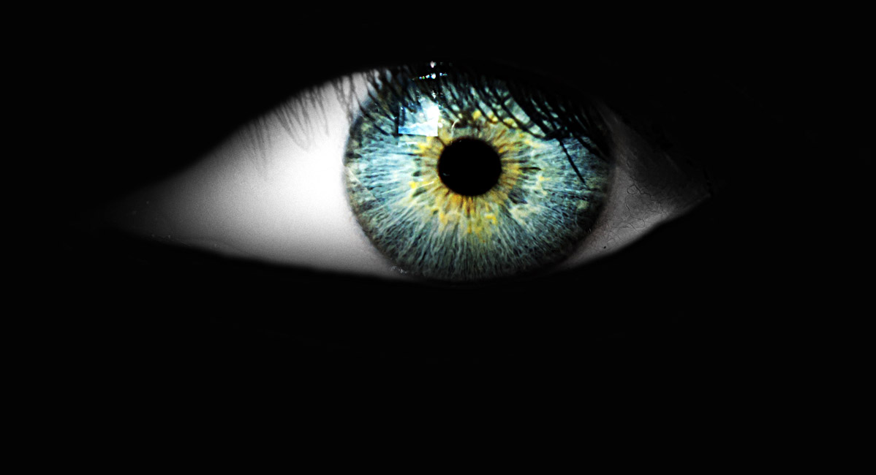
Eye-tracking demo

